Slide 1
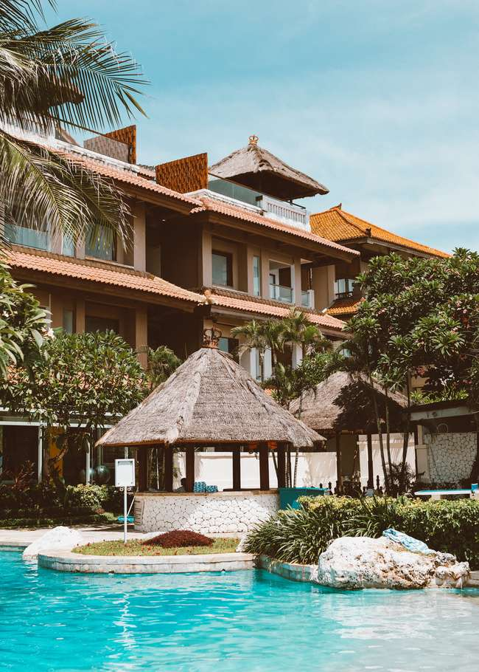

AtliQ Grand
HospitalityAnalysis

Slide 2
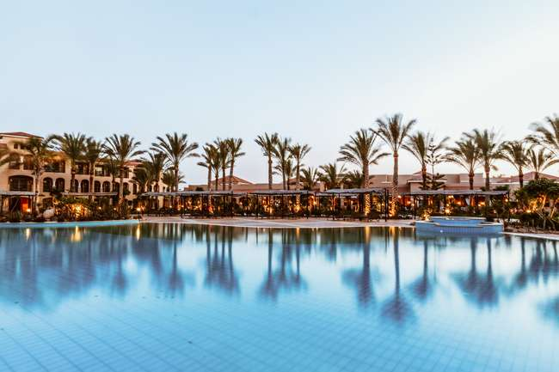
01.
Introduction
05.
model View
Table
of Content
02.
Project Goal
06.
Data Analysis
(Dashboard)
03.
Atliq Hospitality Chain
07.
Recommendations
04.
Problem statement & Key metrices
08.
Insights
01

Slide 3
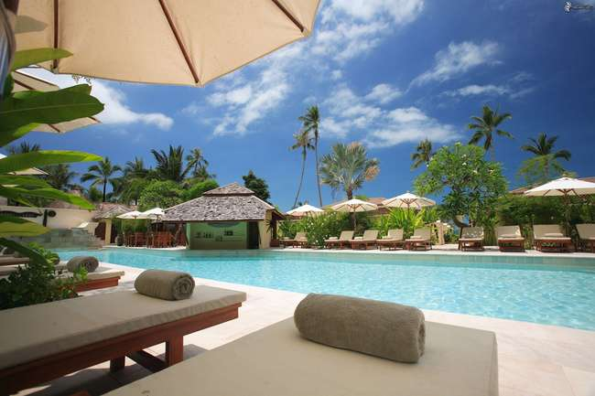
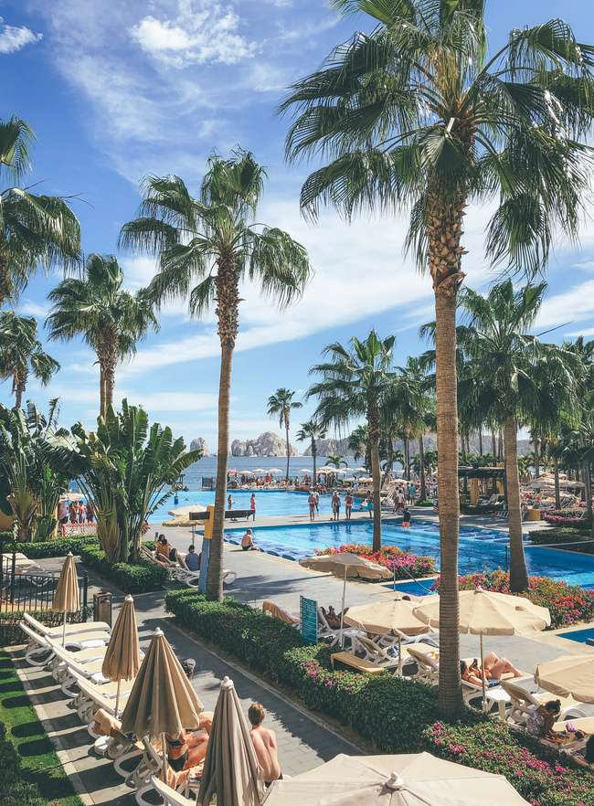
INTRODUCTION
AtliQ Grands proudly owns a collection of five hotels in the major Indian cities such as Delhi, Mumbai, Hyderabad, Bangalore.
"Atliq Grands, a well-established player in India's hotel industry, is facing tough competition and declining revenue in the luxury and business hotel sector. This is because of poor decisions and strong competitors. To fix this, their management team has decided to use data and smart strategies. They don't have their own data experts, so they are hiring an outside company to help them make better decisions and win back customers and money."
02

Slide 4
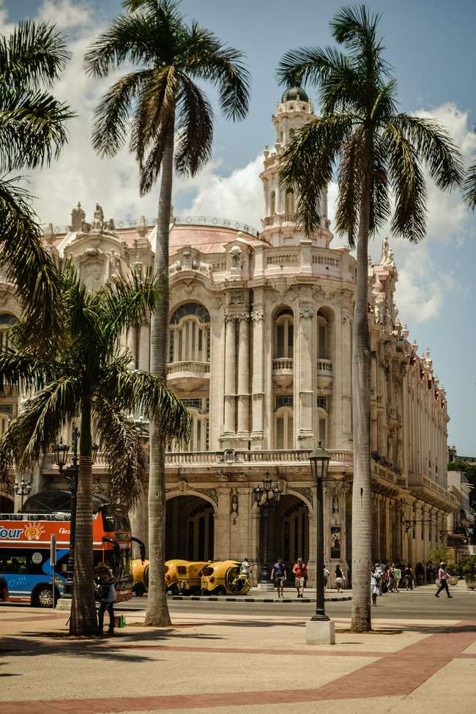

Project Goal
► "To enhance Atliq Grands market share and revenue in the luxury and business hotel segment by implementing data-driven strategies and business intelligence, with the ultimate aim of outperforming competitors and making more informed management decisions."
03

Slide 5
AtliQ Grands Hospitality Chain :
Category
Luxury
Business
Property Name
Property Name
Atliq Grands
AtliQ City
AtliQ Exotica
AtliQ Palace
AtliQ Blu
AtliQ Seasons
AtliQ Bay
Each property name has 4 room class
04
standard
elite
premium
presidential

Slide 6
Key metrics formula
Calculated Column Name | Description / Purpose | DAX formula
wn | To get the week number from the corresponding date. | wn = WEEKNUM(dim_date[date])
day type | Based on the feedback from stakeholder, we considered Friday and Saturday as weekend and weekdays from Sunday to Thurdsay. In PowerBI, Sunday weekday number is 1, Monday is 2 and so on. So, if weekday number is greater than 5, then weekend or else weekday. https://learn.microsoft.com/en-us/dax/weekday-function-dax | day type = Var wkd = WEEKDAY(dim_date[date],1) return IF( wkd>5,"Weekend","Weekday")
05

Slide 7
Key metrics formula
1 | Revenue | To get the total revenue_realized | Revenue = SUM(fact_bookings[revenue_realized])
2 | Total Bookings | To get the total number of bookings happened | Total Bookings = COUNT(fact_bookings[booking_id])
3 | Total Capacity | To get the total capacity of rooms present in hotels | Total Capacity = SUM(fact_aggregated_bookings[capacity])
4 | Total Succesful Bookings | To get the total succesful bookings happened for all hotels | Total Succesful Bookings = SUM(fact_aggregated_bookings[successful_bookings])
5 | Occupancy % | Occupancy means total successful bookings happened to the total rooms available(capacity) | Occupancy % = DIVIDE([Total Succesful Bookings],[Total Capacity],0)
6 | Average Rating | Get the average ratings given by the customers | Average Rating = AVERAGE(fact_bookings[ratings_given])
7 | No of days | To get the total number of days present in the data. In our case, we have data from May to July. So 92 days. | No of days = DATEDIFF(MIN(dim_date[date]),MAX(dim_date[date]),DAY) +1
8 | Total cancelled bookings | To get the"Cancelled" bookings out of all Total bookings happened | Total cancelled bookings = CALCULATE([Total Bookings],fact_bookings[booking_status]="Cancelled")
9 | Cancellation % | calculating the cancellaton percentage. | Cancellation % = DIVIDE([Total cancelled bookings],[Total Bookings])
10 | Total Checked Out | To get the successful 'Checked out' bookings out of all Total bookings happened | Total Checked Out = CALCULATE([Total Bookings],fact_bookings[booking_status]="Checked Out")
11 | Total no show bookings | To get the"No Show" bookings out of all Total bookings happened ("No show" means those customers who neither cancelled nor attend to their booked rooms) | Total no show bookings = CALCULATE([Total Bookings],fact_bookings[booking_status]="No Show")
12 | No Show rate % | calculating the no show percentage. | No Show rate % = DIVIDE([Total no show bookings],[Total Bookings])
13 | Booking % by Platform | To show the percentage contribution of each booking platform for bookings in hotels. We have booking platforms like makeyourtrip, logtrip, tripster etc) | Booking % by Platform = DIVIDE([Total Bookings], CALCULATE([Total Bookings], ALL(fact_bookings[booking_platform]) ))*100
06

Slide 8
Key metrics formula
14 | Booking % by Room class | To show the percentage contribution of each room class over total rooms booked. We have room classes like Standard, Elite, Premium, Presidential. | Booking % by Room class = DIVIDE([Total Bookings], CALCULATE([Total Bookings], ALL(dim_rooms[room_class]) ))*100
15 | ADR | Calculate the ADR(Average Daily rate) It is the ratio of revenue to the total rooms booked/sold. It is the measure of the average paid for rooms sold in a given time period | ADR = DIVIDE( [Revenue], [Total Bookings],0)
16 | Realisation % | calculate the realisation percentage. It is nothing but the succesful "checked out" percentage over all bookings happened. | Realisation % = 1- ([Cancellation %]+[No Show rate %])
17 | RevPAR | Calculate the RevPAR(Revenue Per Available Room) RevPAR represents the revenue generated per available room, whether or not they are occupied. RevPAR helps hotels measure their revenue generating performance to accurately price rooms. RevPAR can help hotels measure themselves against other properties or brands. | RevPAR = DIVIDE([Revenue],[Total Capacity])
18 | DBRN | calculate DBRN(Daily Booked Room Nights) This metrics tells on average how many rooms are booked for a day considering a time period | DBRN = DIVIDE([Total Bookings], [No of days])
19 | DSRN | calculate DSRN(Daily Sellable Room Nights) This metrics tells on average how many rooms are ready to sell for a day considering a time period | DSRN = DIVIDE([Total Capacity], [No of days])
07

Slide 9
Key metrics formula
24 | Revpar WoW change % | To get the RevPar(Revenue Per Available Room) change percentage week over week. Here, revcw for current week revpw for previous week | Revpar WoW change % = Var selv = IF(HASONEFILTER(dim_date[wn]),SELECTEDVALUE(dim_date[wn]),MAX(dim_date[wn])) var revcw = CALCULATE([RevPAR],dim_date[wn]= selv) var revpw = CALCULATE([RevPAR],FILTER(ALL(dim_date),dim_date[wn]= selv-1)) return DIVIDE(revcw,revpw,0)-1
25 | Realisation WoW change % | To get the Realisation change percentage week over week. Here, revcw for current week revpw for previous week | Realisation WoW change % = Var selv = IF(HASONEFILTER(dim_date[wn]),SELECTEDVALUE(dim_date[wn]),MAX(dim_date[wn])) var revcw = CALCULATE([Realisation %],dim_date[wn]= selv) var revpw = CALCULATE([Realisation %],FILTER(ALL(dim_date),dim_date[wn]= selv-1)) return DIVIDE(revcw,revpw,0)-1
26 | DSRN WoW change % | To get the DSRN(Daily Sellable Room Nights) change percentage week over week. Here, revcw for current week revpw for previous week | DSRN WoW change % = Var selv = IF(HASONEFILTER(dim_date[wn]),SELECTEDVALUE(dim_date[wn]),MAX(dim_date[wn])) var revcw = CALCULATE([DSRN],dim_date[wn]= selv) var revpw = CALCULATE([DSRN],FILTER(ALL(dim_date),dim_date[wn]= selv-1)) return DIVIDE(revcw,revpw,0)-1
08

Slide 10
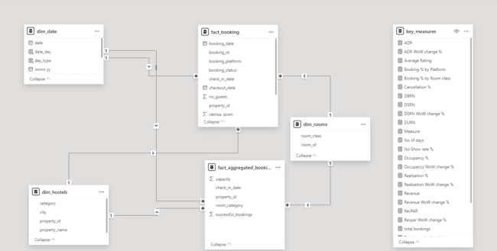
Model View
09

Slide 11
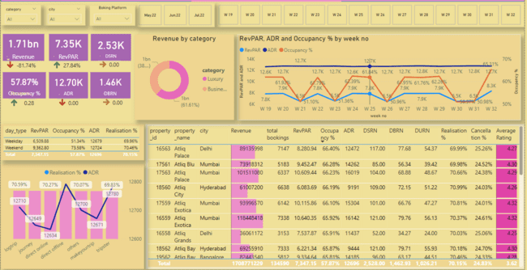
Dashboard
10

Slide 12
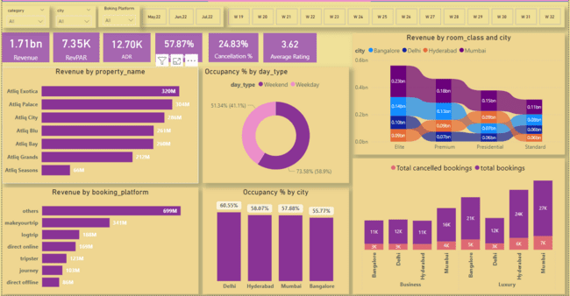
Dashboard
11

Slide 13
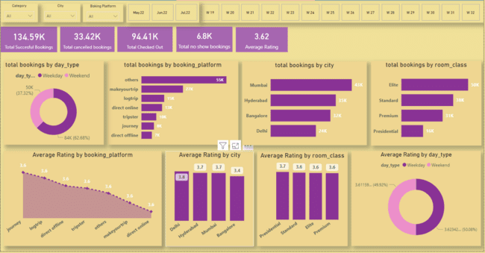
Dashboard
12

Slide 14
Insights
► Mumbai generated highest revenue (669M) and Delhi generated lowest revenue(290.92M)
► Luxury generated more revenue i.e 61.62% as compared to Business category which generated 38.82% of total
revenue i.e 1.69 billion.
► Occupancy % is highest for Delhi i.e.60.44% in spite of having lowest DSRN i.e.435 and lowest for Bangalore
i.e. 55.68%.
► AtliQ Exotica is the best performer among all properties with 316M revenue, average rating is 3.62, occupancy %
is 57.20% and cancellation rate is 24.39%.
► On Weekend (fri-sat) Occupancy % is 7% more than weekdays but difference in RevPAR is negligible.
► Highest revenue generated in the month of may compared to June and July which is 581.93 м.
► Elite room class generated highest revenue of 553.74 M whereas standard room class generated the lowest
revenue of 305.74 M
► Maximum number of booking are from other sources (19K) followed by makeyourtrip(9K).
► Overall revenue is 1.69 billion, occupancy % is 57.79%, cancellation % is 24.84% and average rating 3.62.
► RevPAR is highest for Mumbai i.e. 8.9K and lowest for Hyderabad i.e 5.4 Κ.
13

Slide 15

Recomondation
► Ratings given by customers can be improved by good service, cleanliness, best food etc. as it has direct impact on bookings and revenue.
► ADR is almost same on weekdays and weekends. So dynamic pricing can be set for all properties and platforms for more revenue generation.
► Makeyourtrip has second largest source for maximum booking (9k) but cancellation % is 25.03% across all cities and properties. Management team should identify this issue as it impacts hotel ranking in search results which leads to less revenue and less bookings.
► As overall occupancy % is 57.79% management team can dynamically set room prices in properties having low occupancy %.
14

Slide 16
Thank You for Watching
15

